Slide 1
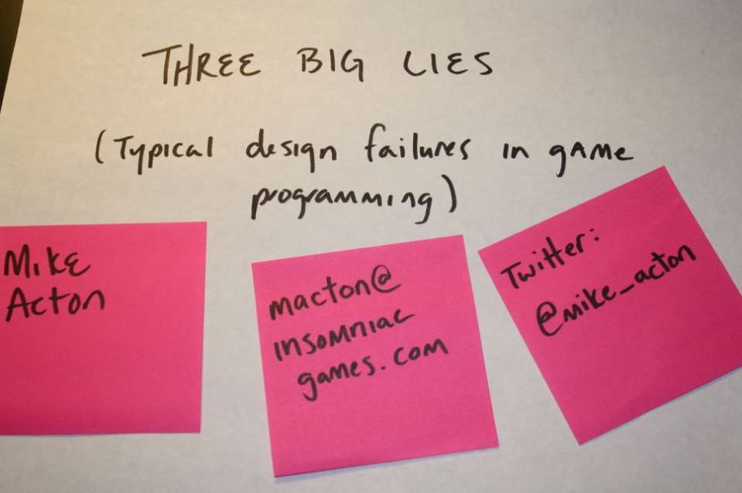
1

Slide 2

2

Slide 3

3

Slide 4

4

Slide 5

5

Slide 6

6

Slide 7
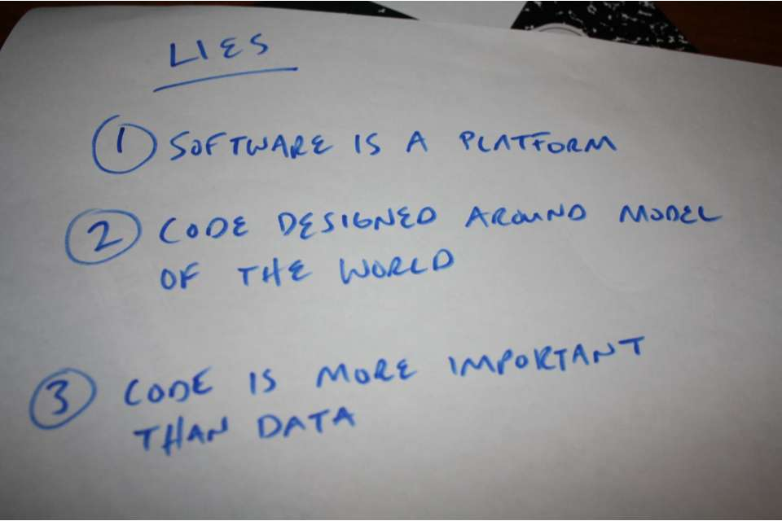
7

Slide 8
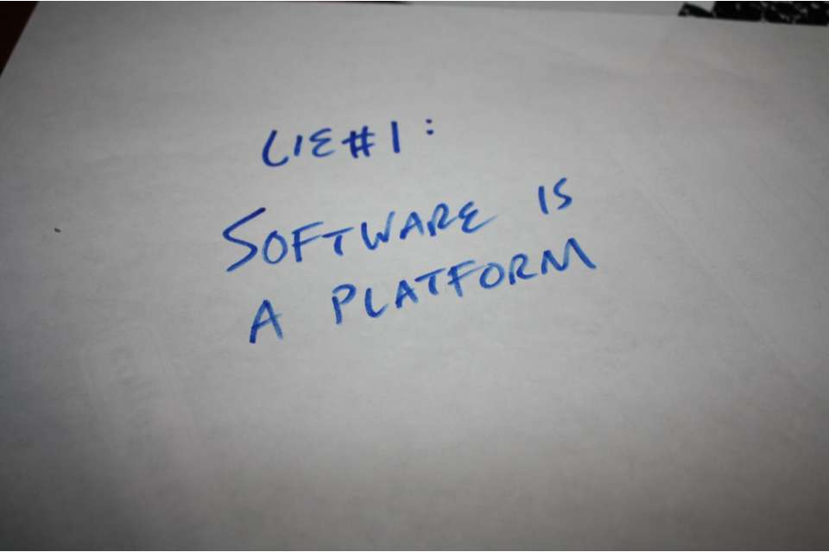
8

Slide 9

9

Slide 10
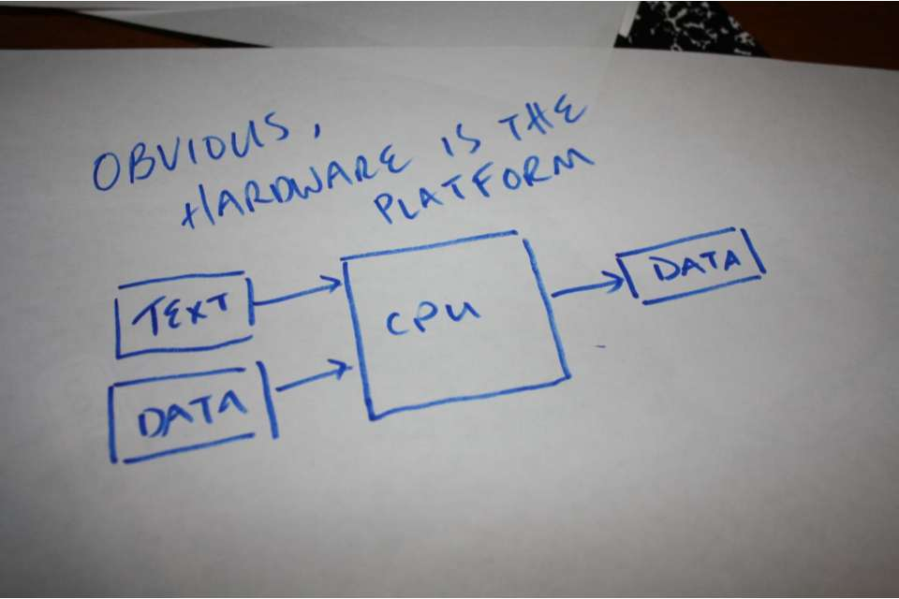
10

Slide 11
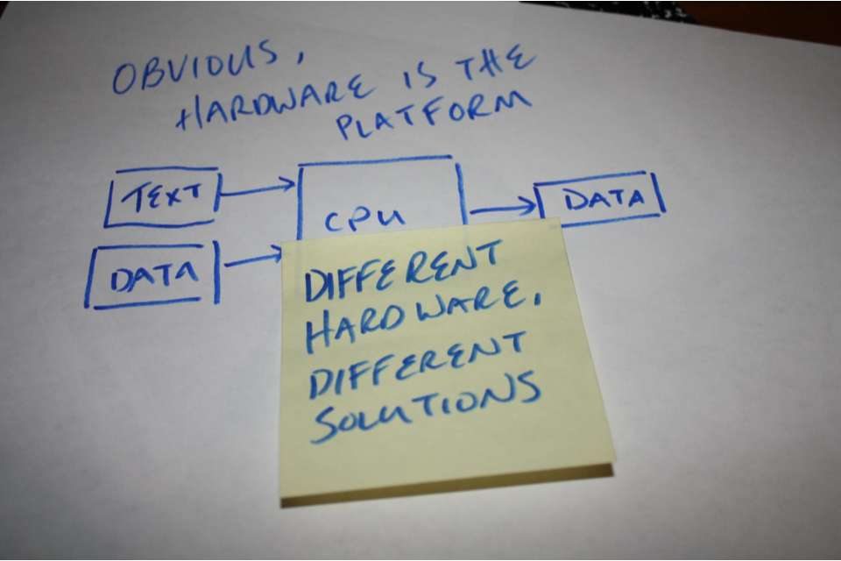
11

Slide 12
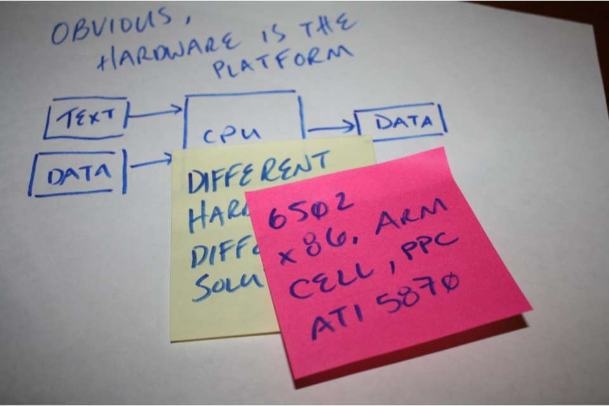
12

Slide 13

13

Slide 14
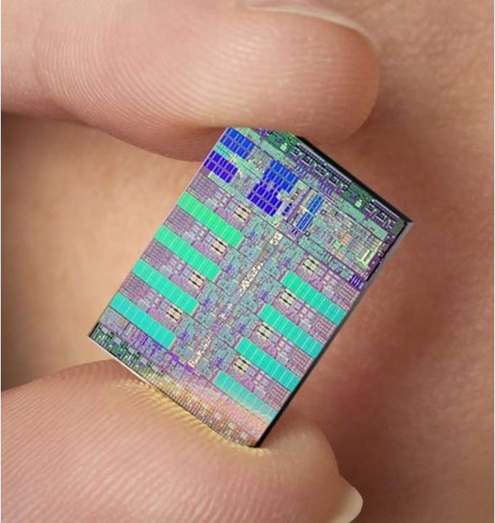
14
Cell Processor

Slide 15


15
Cell Processor

Slide 16


16
Cell Processor

Slide 17


17
Cell Processor

Slide 18


18
Cell Processor

Slide 19
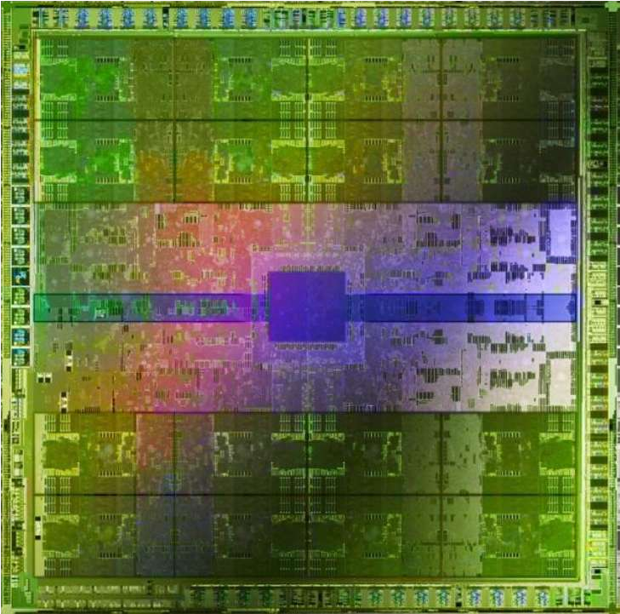
NVidia Fermi (GF100)
19

Slide 20


NVidia Fermi (GF100)
20

Slide 21
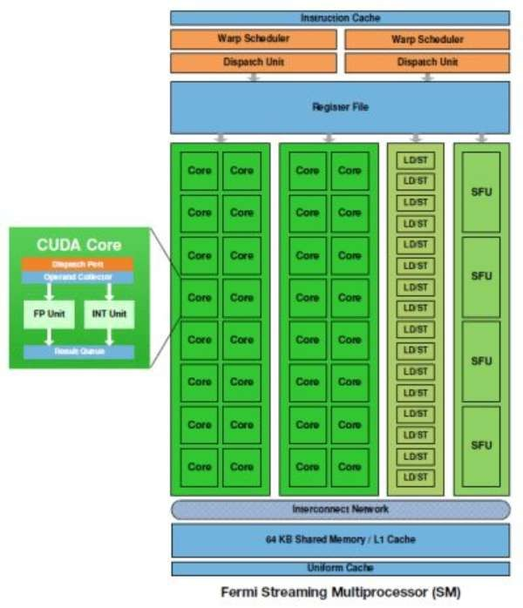
21

Slide 22


NVidia Fermi (GF100)
22

Slide 23
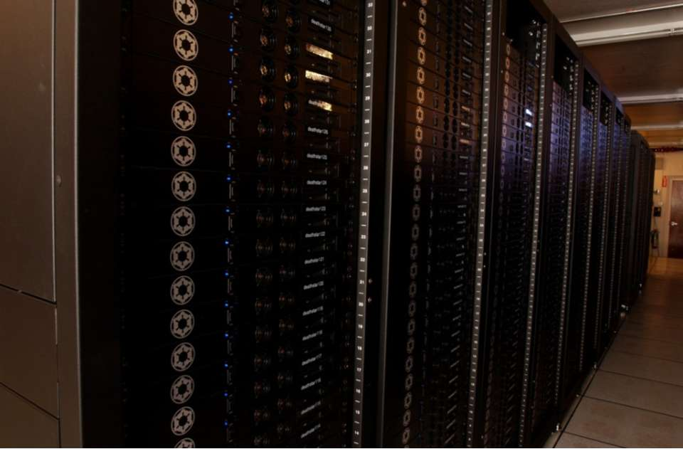
ILM's RackSaver Linux renderfarm
(1,500 processors, circa 2003)
23

Slide 24
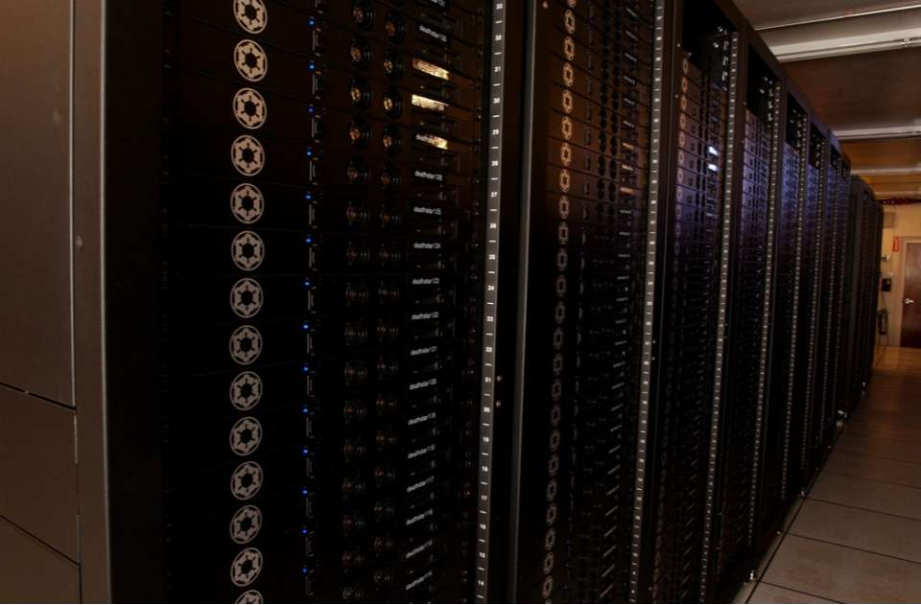


ILM's RackSaver Linux renderfarm
(1,500 processors, circa 2003)
24

Slide 25
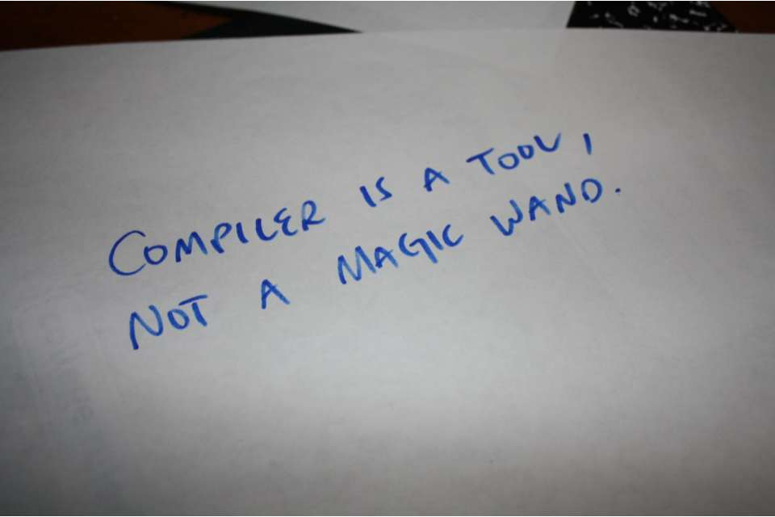
25

Slide 26

26

Slide 27
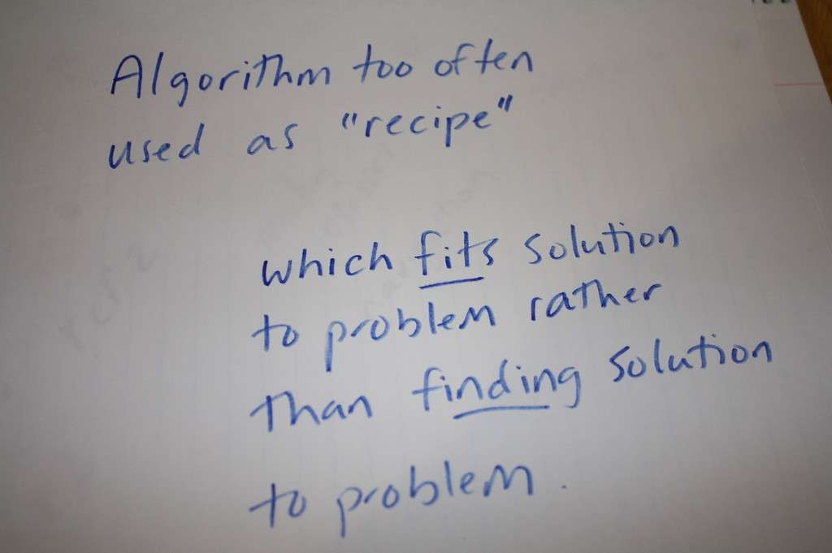
27

Slide 28
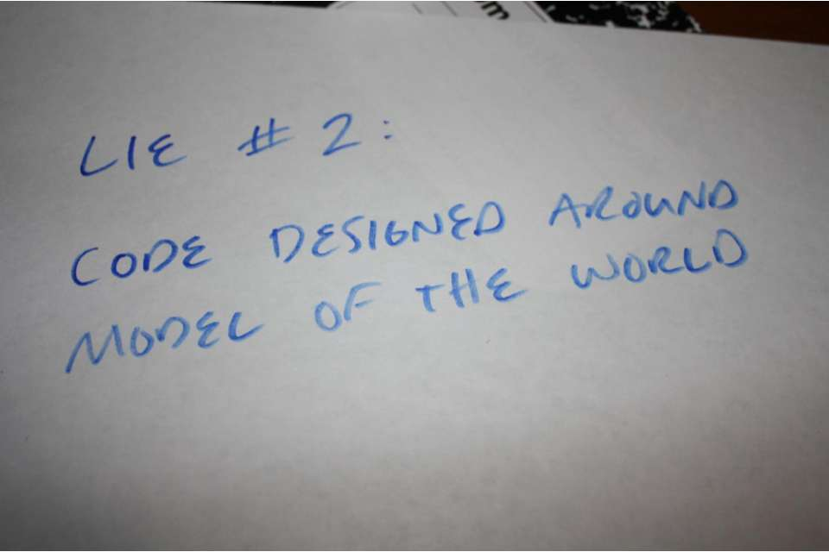
28

Slide 29

29

Slide 30
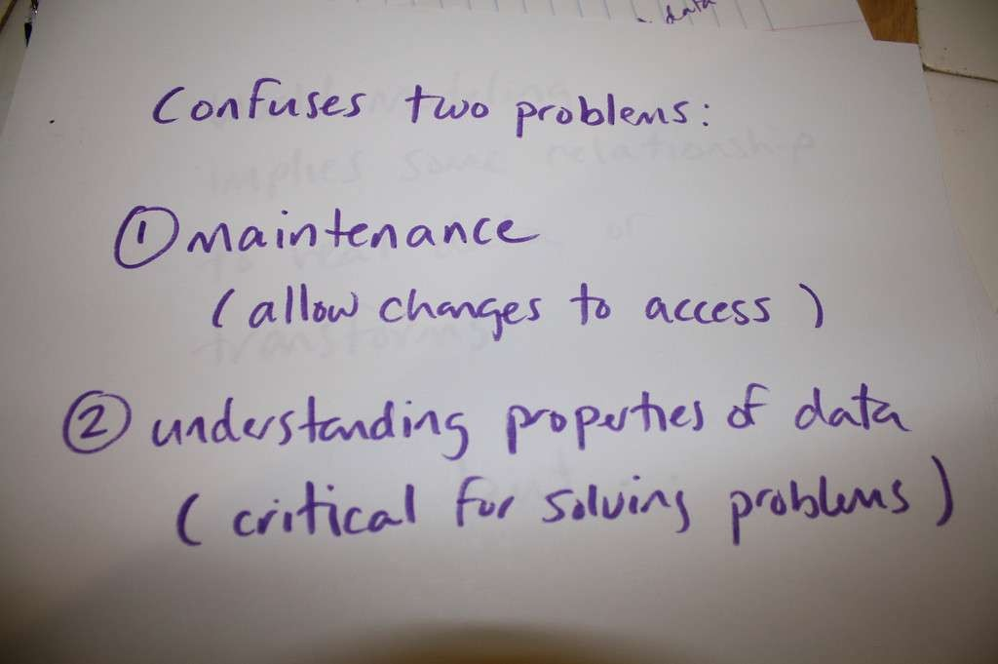
30

Slide 31

31

Slide 32

32

Slide 33
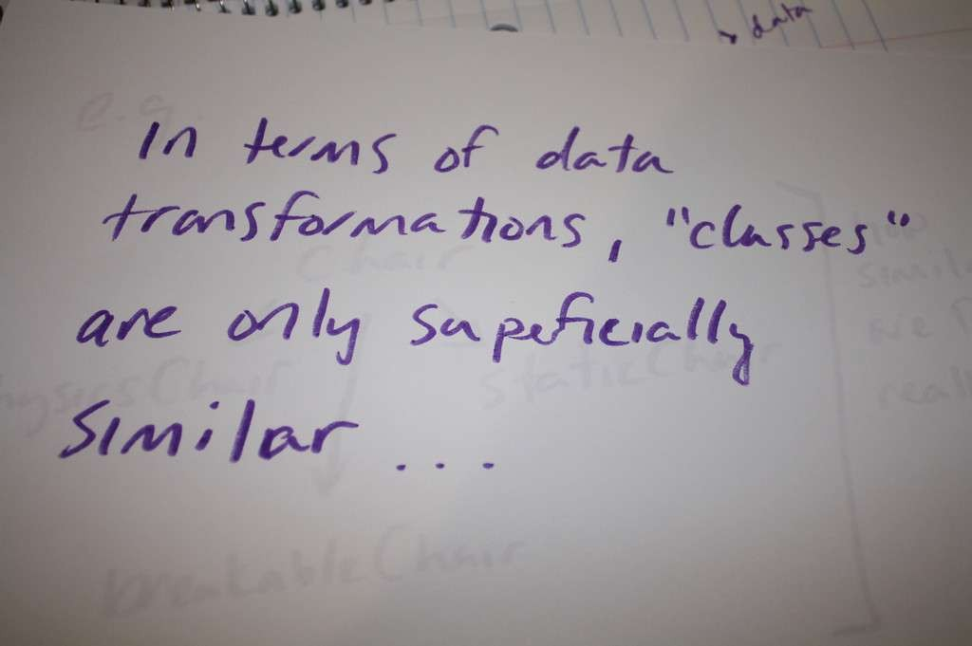
33

Slide 34
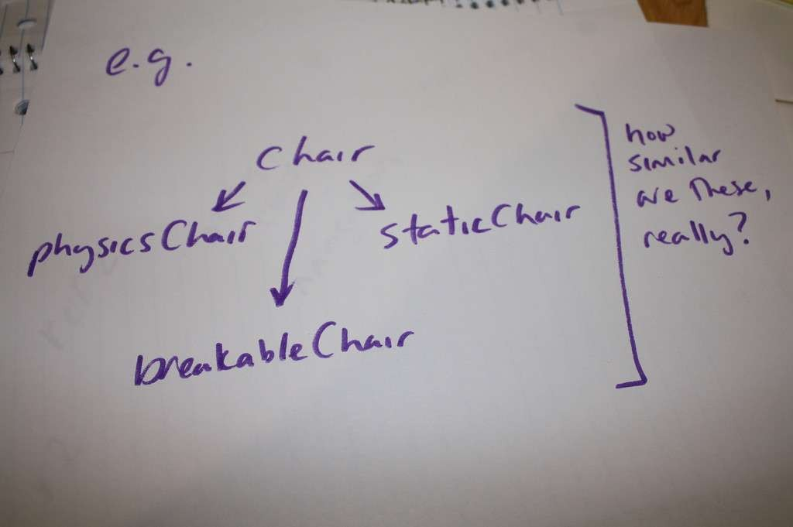
34

Slide 35
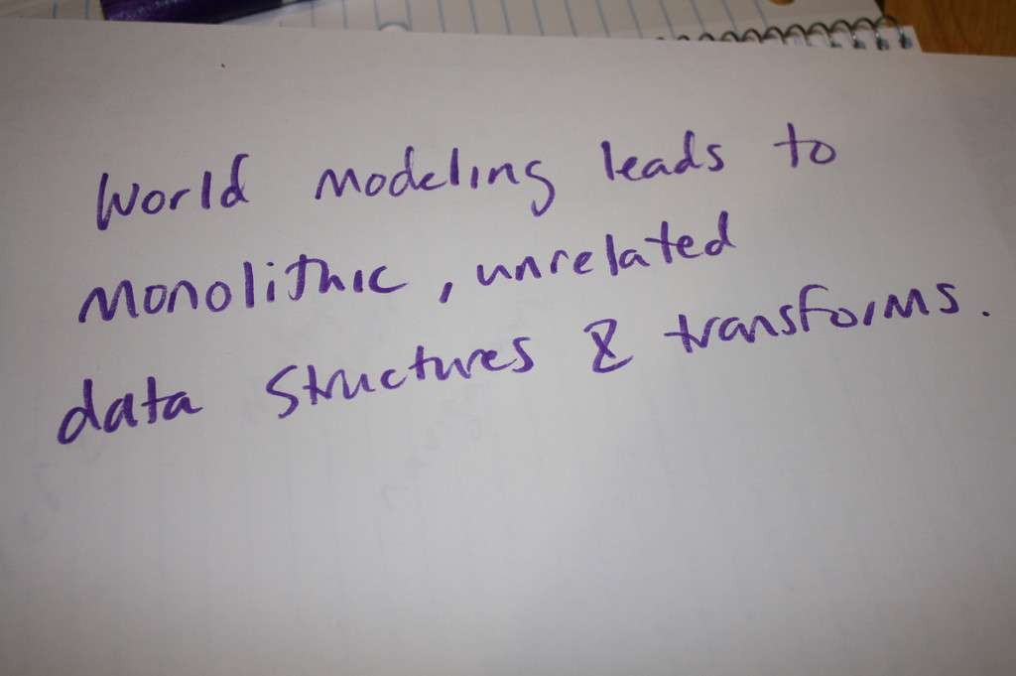
35

Slide 36
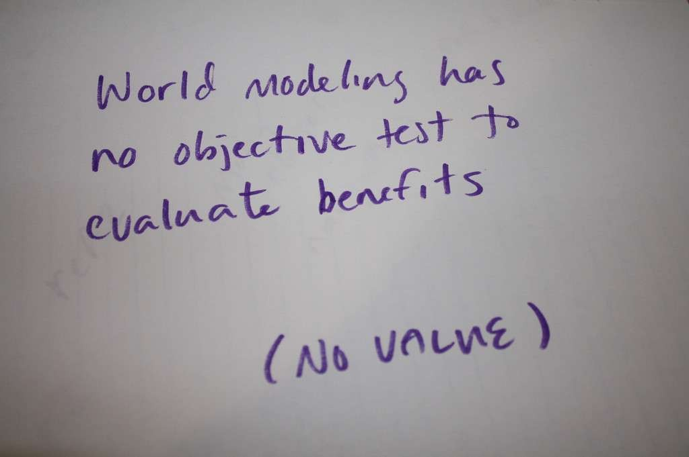
36

Slide 37
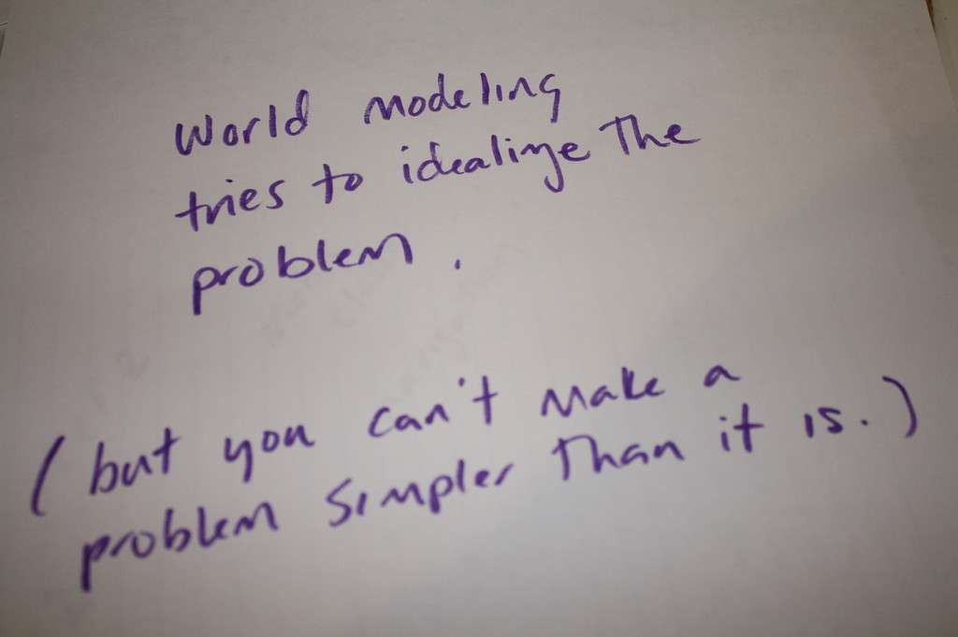
37

Slide 38

38

Slide 39
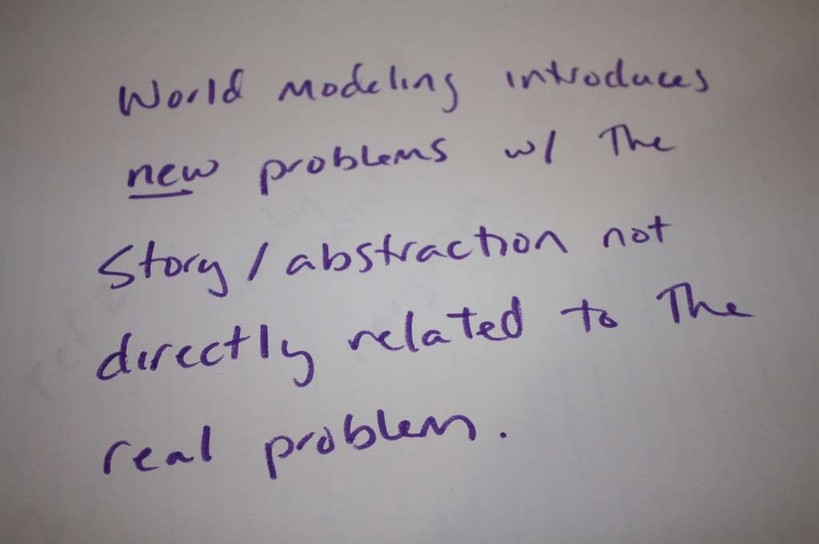
39

Slide 40
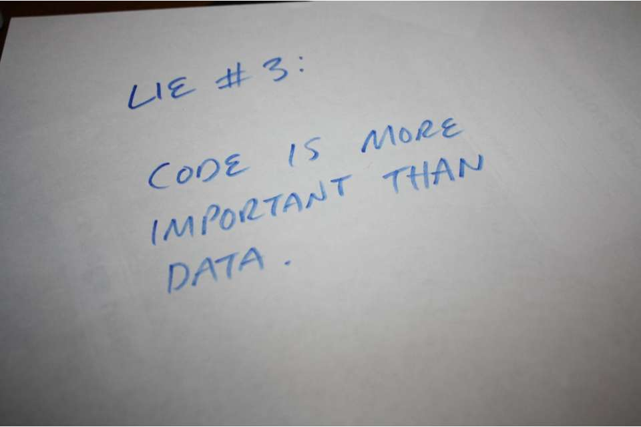
40

Slide 41
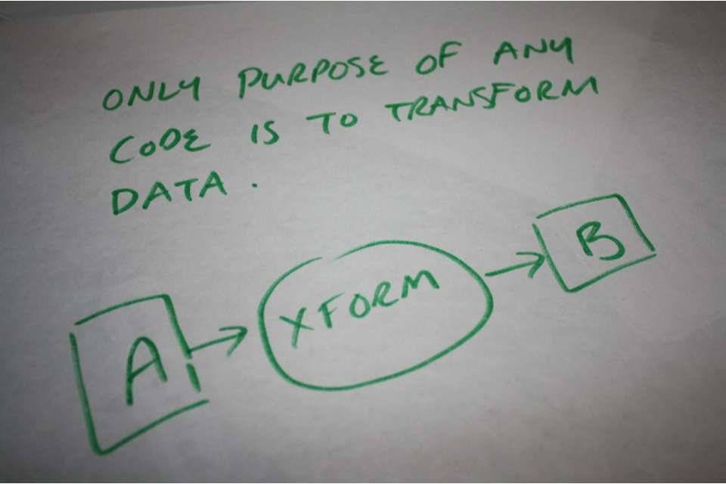
41

Slide 42
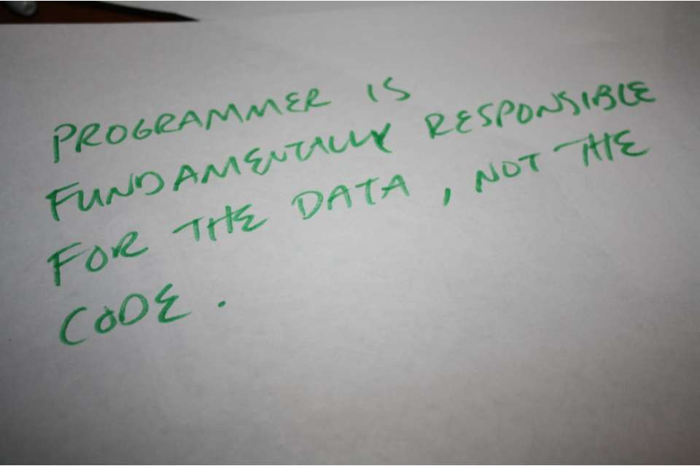
42

Slide 43
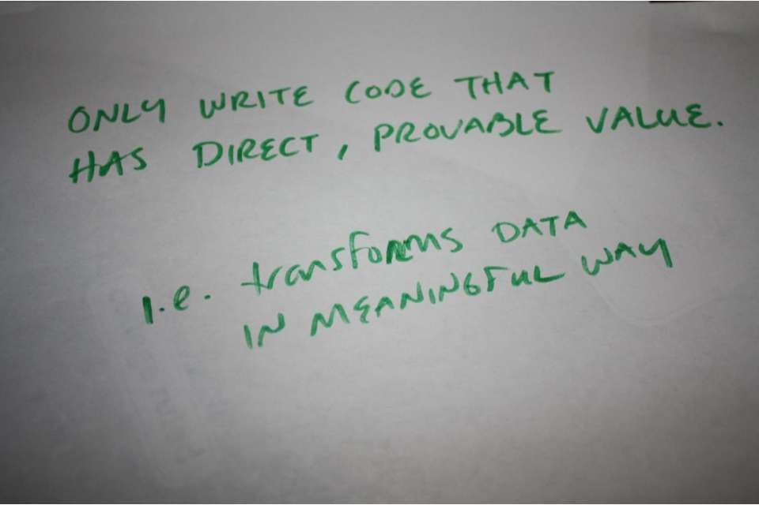
43

Slide 44
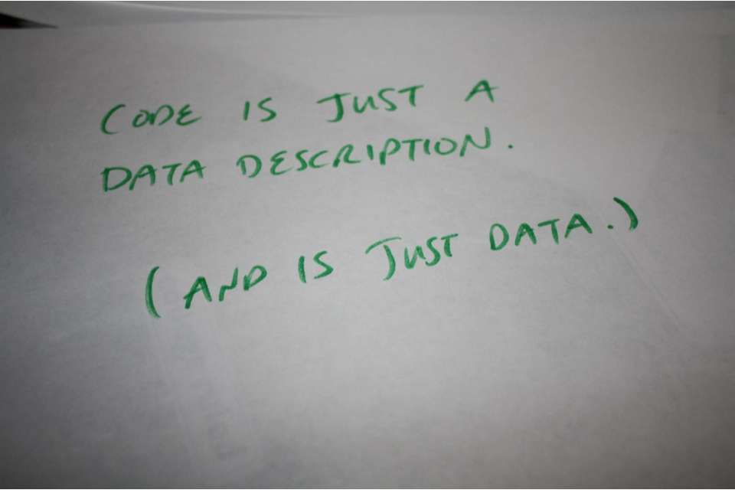
44

Slide 45

45

Slide 46
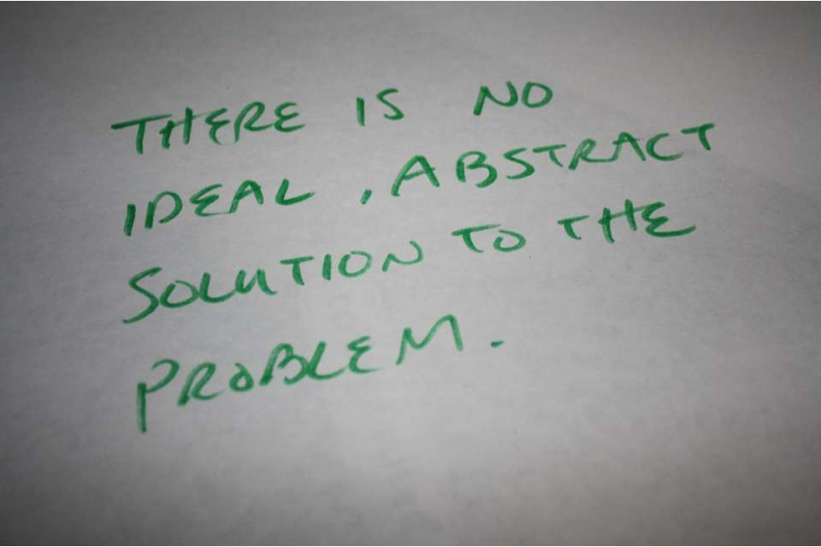
46

Slide 47

47

Slide 48
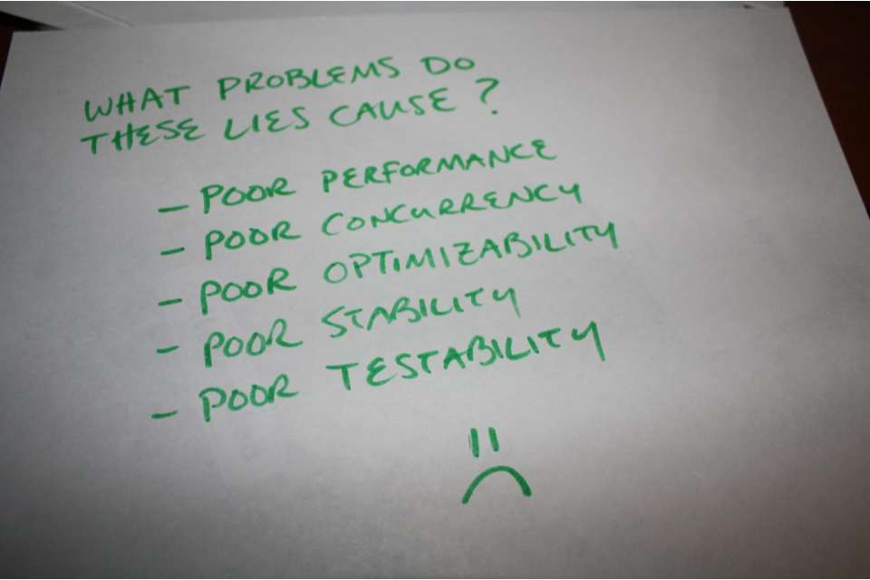
48

Slide 49

49

Slide 50
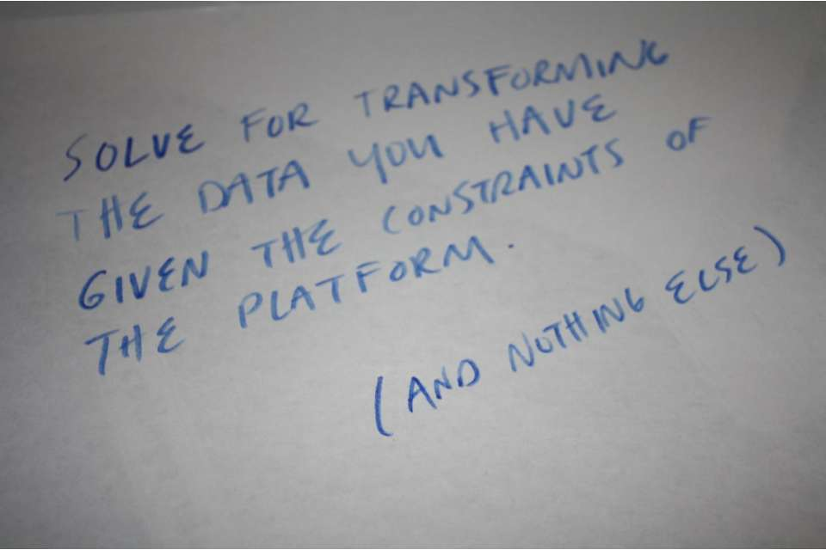
50

Slide 51
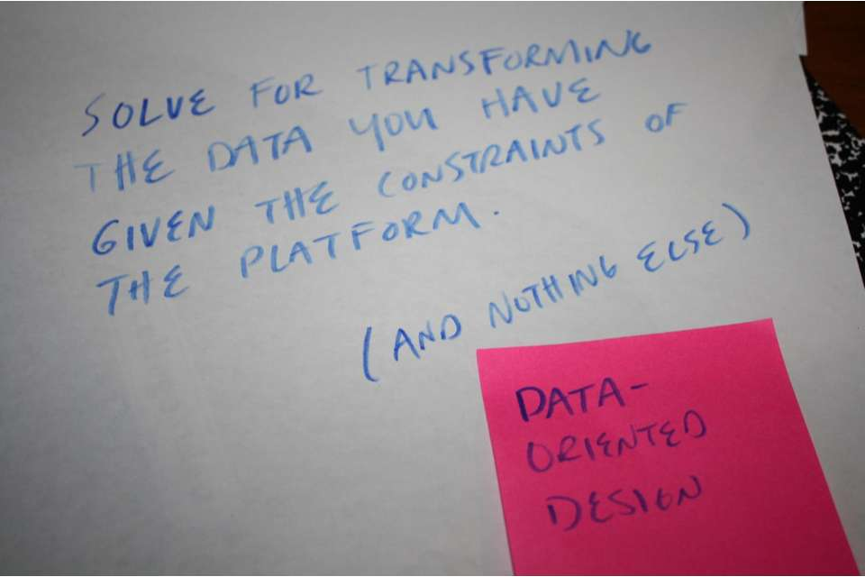
51

Slide 52
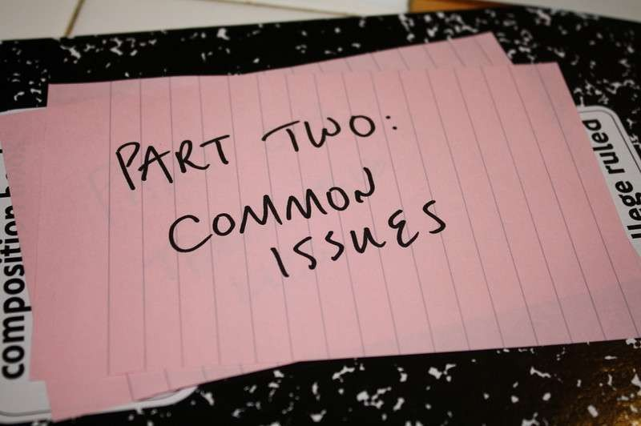
52

Slide 53
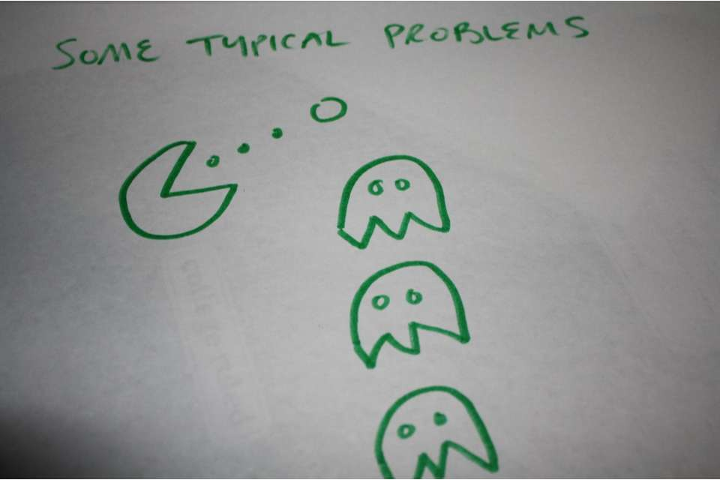
53

Slide 54
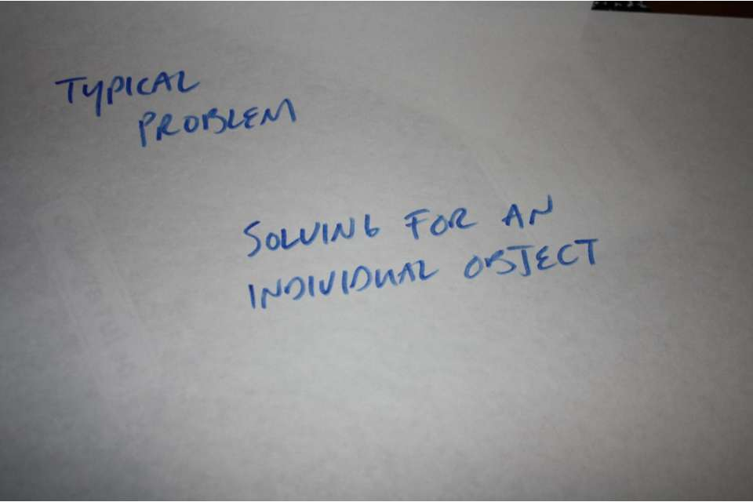
54

Slide 55
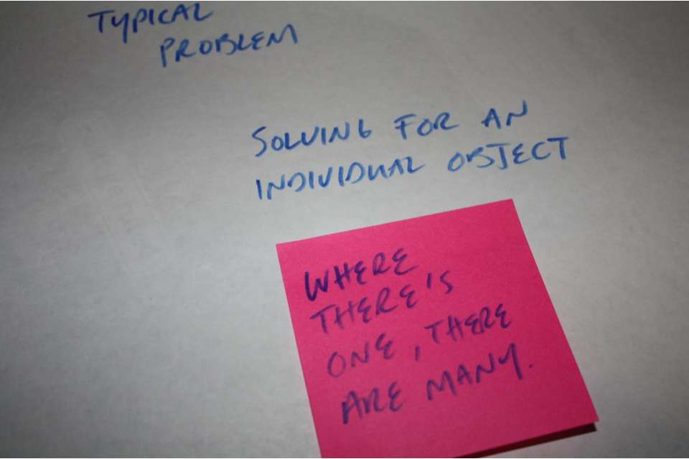
55

Slide 56
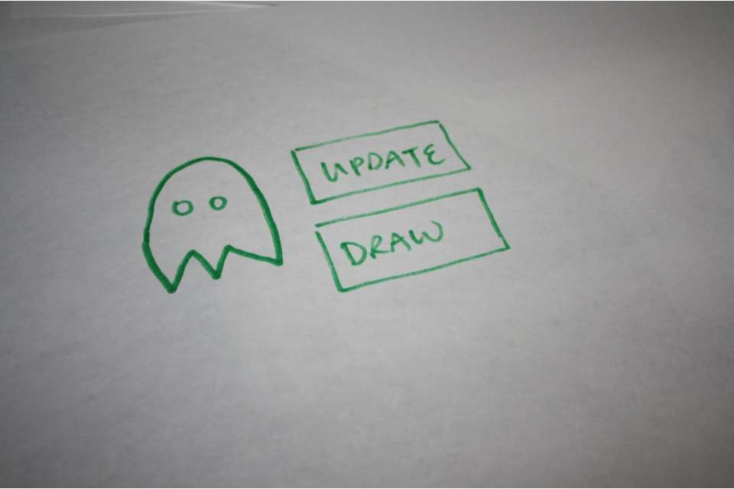
56

Slide 57
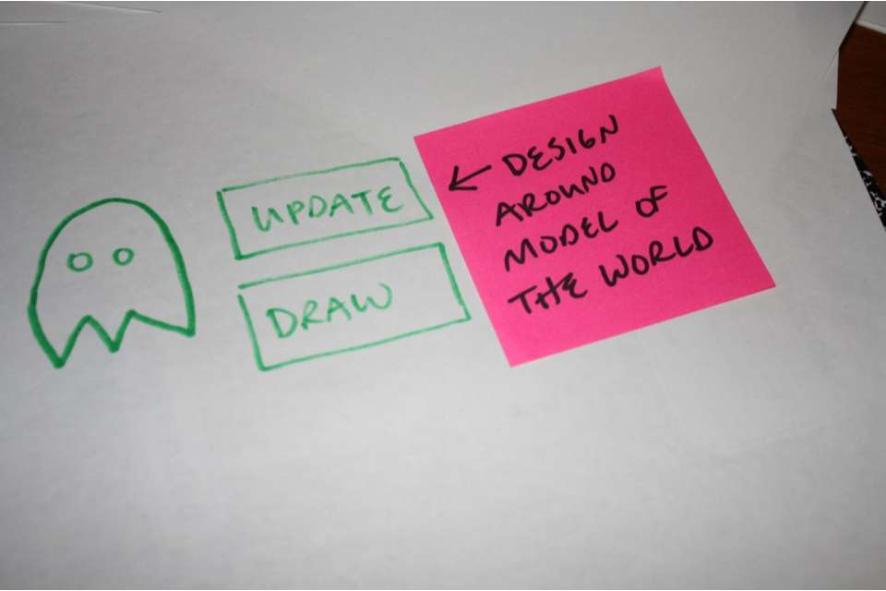
57

Slide 58

58

Slide 59

59

Slide 60

60

Slide 61
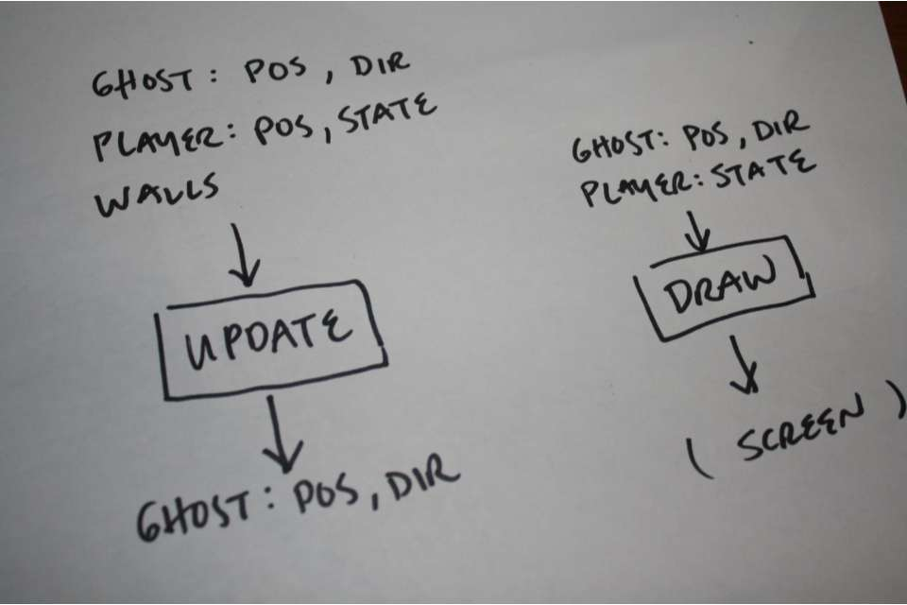
61

Slide 62
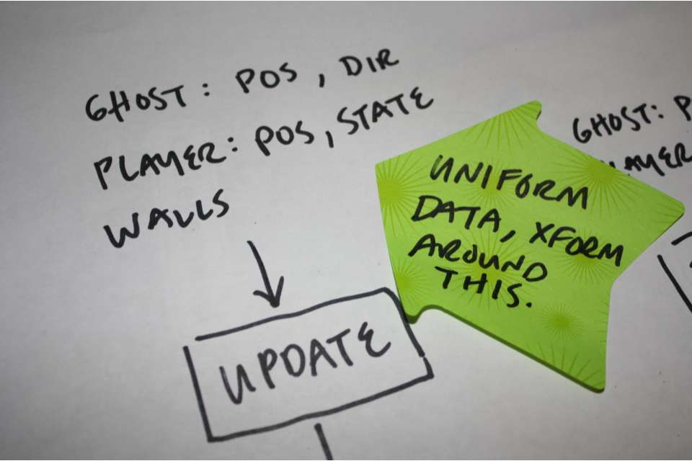
62

Slide 63
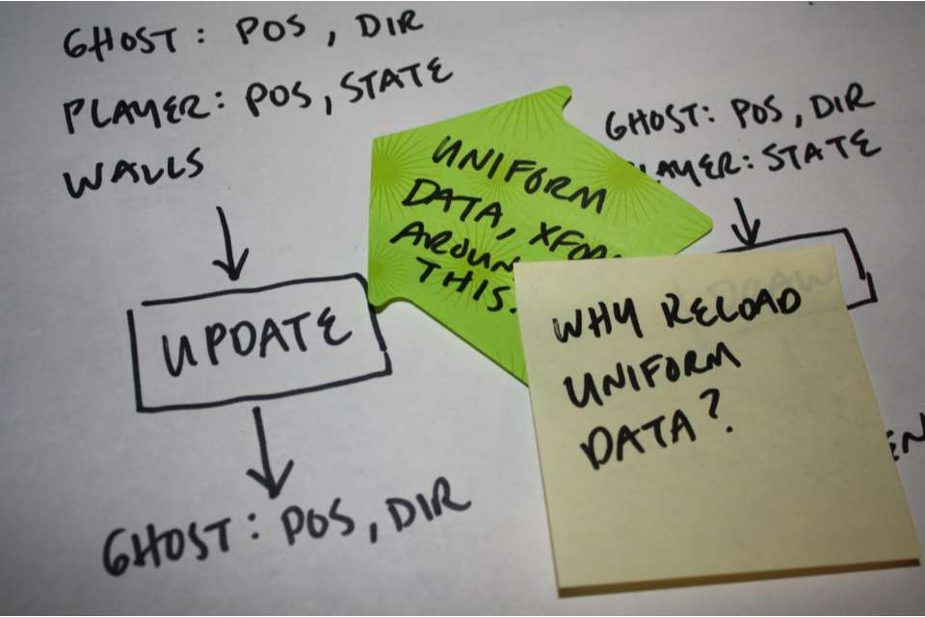
63

Slide 64
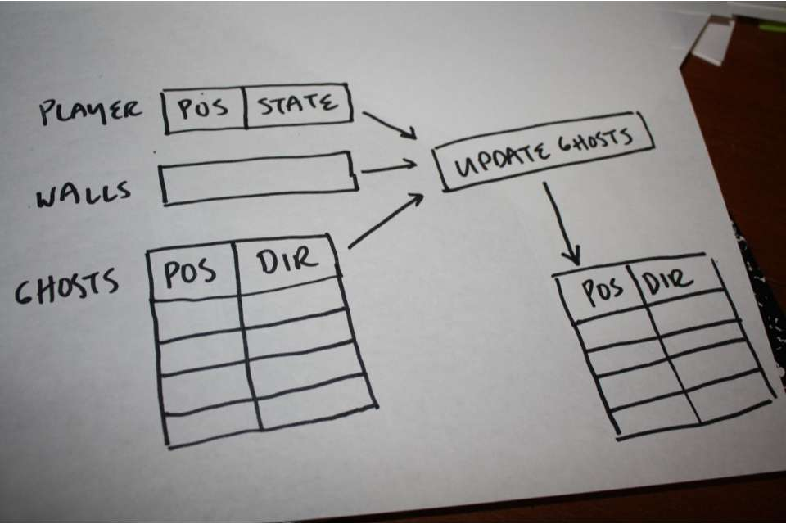
64

Slide 65
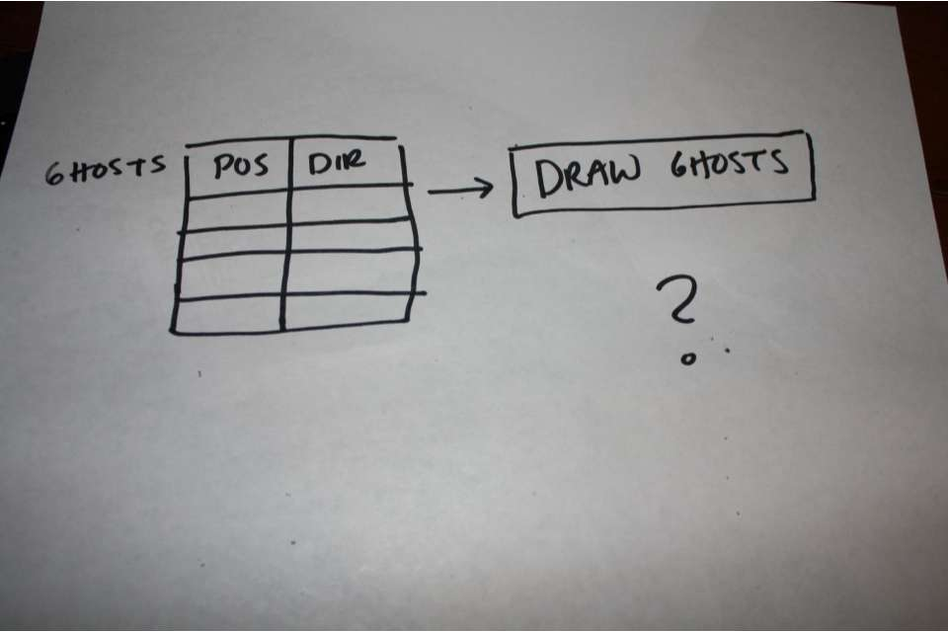
65

Slide 66
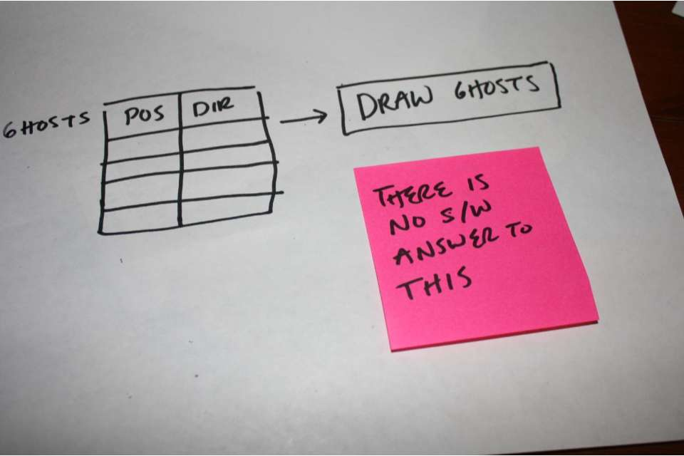
66

Slide 67
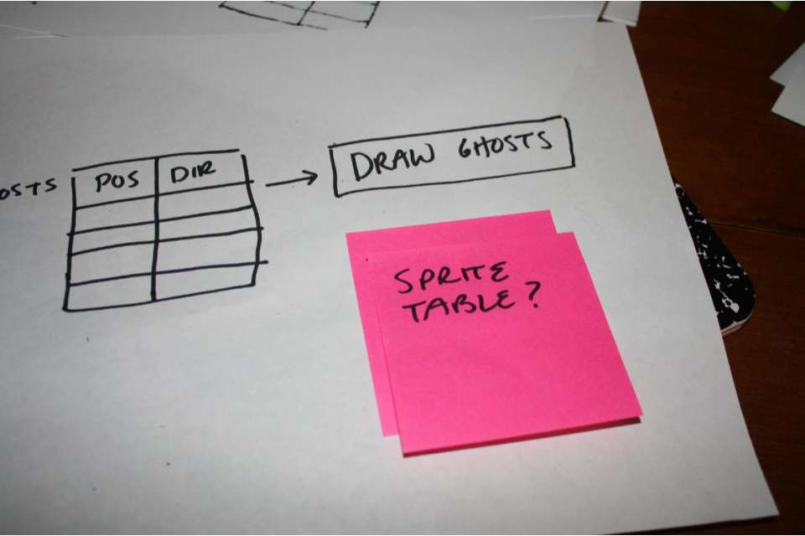
67

Slide 68
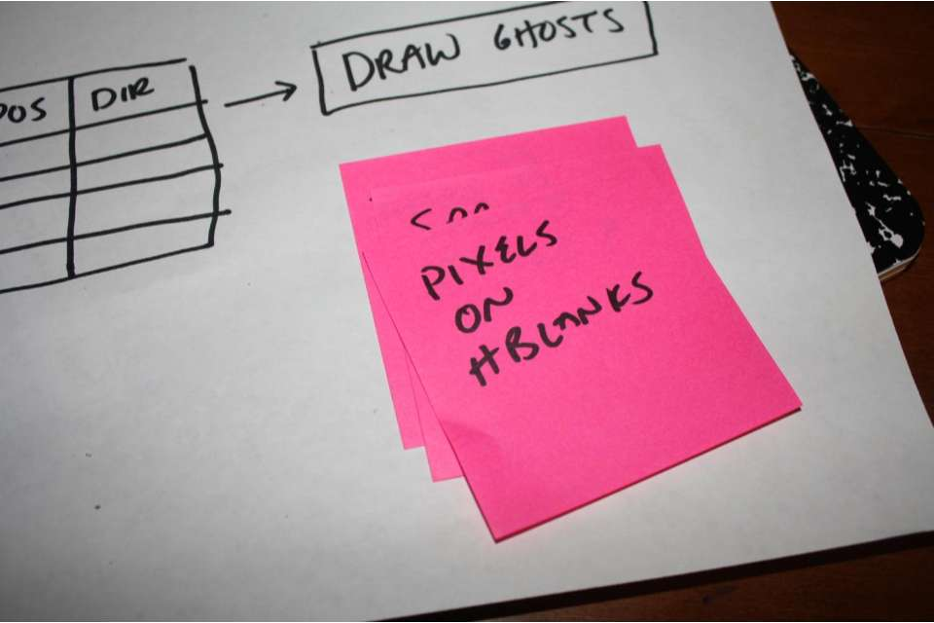
68

Slide 69
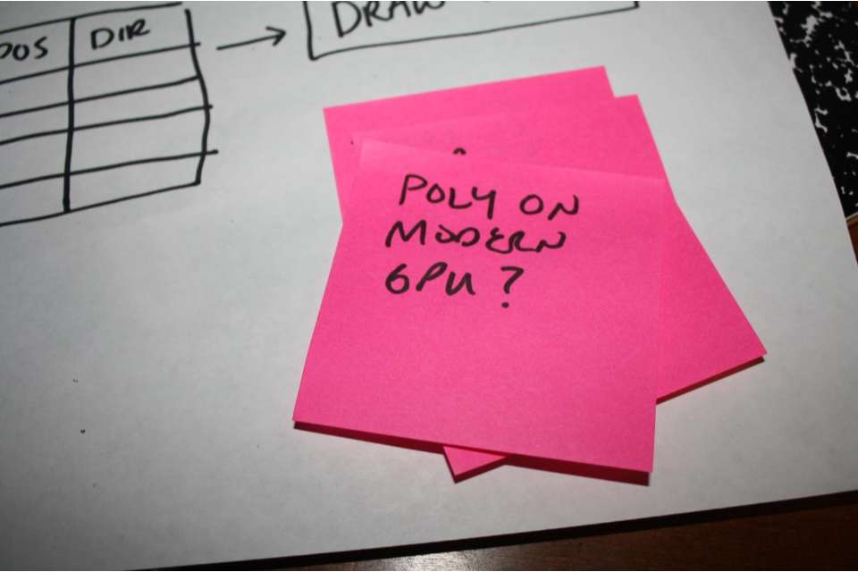
69

Slide 70
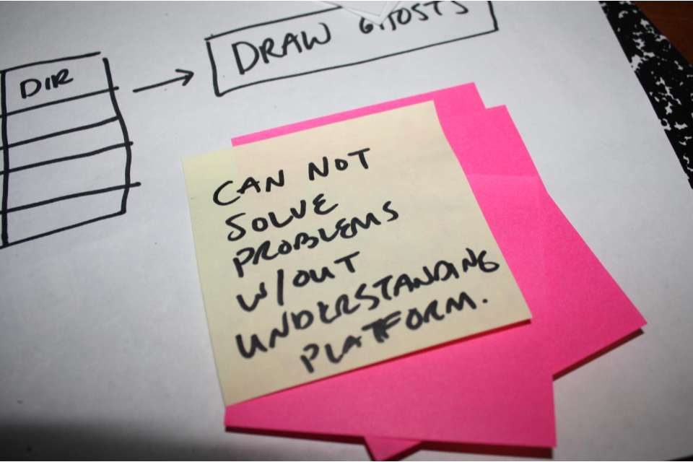
70

Slide 71
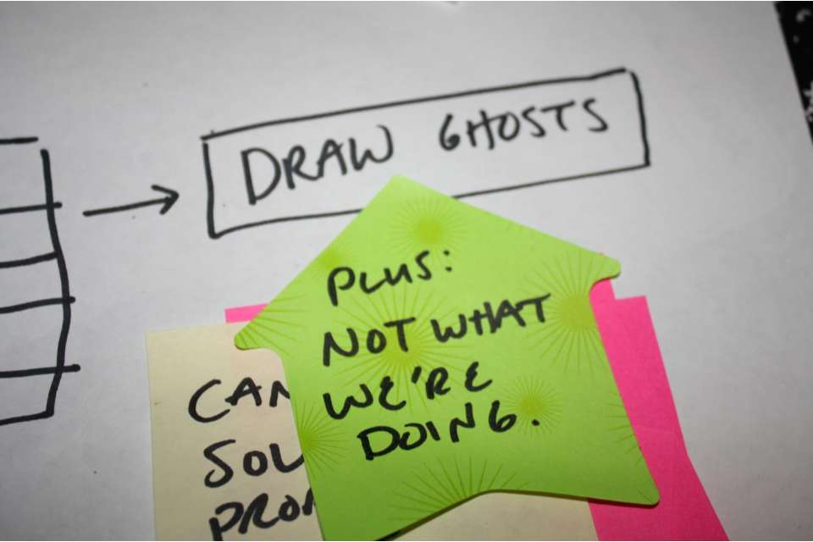
71

Slide 72

72

Slide 73
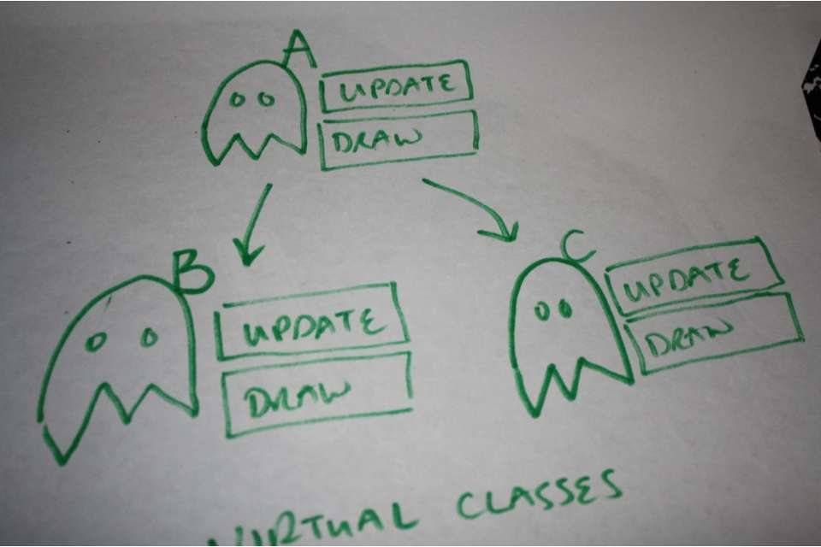
73

Slide 74
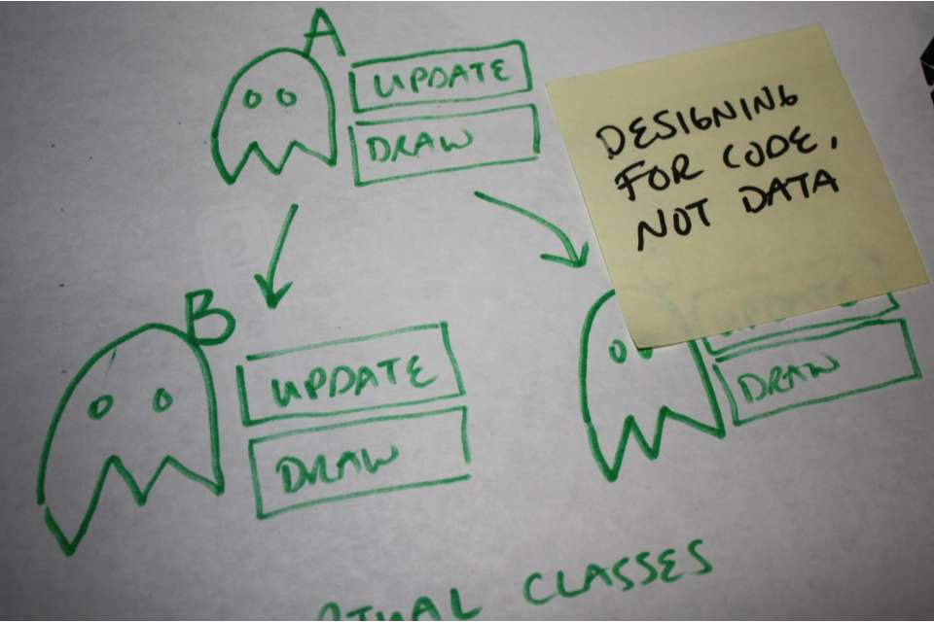
74

Slide 75

75

Slide 76
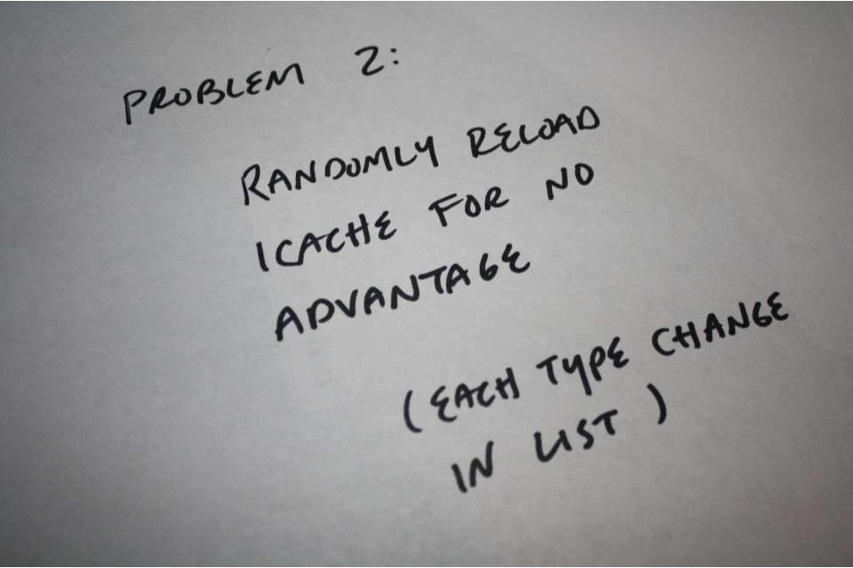
76

Slide 77

77

Slide 78

78

Slide 79

79

Slide 80

80

Slide 81

81

Slide 82

82

Slide 83

83

Slide 84

84

Slide 85

85

Slide 86

86

Slide 87

87

Slide 88

88

Slide 89

89

Slide 90

90

Slide 91

91

Slide 92

92

Slide 93

93

Slide 94

94

Slide 95

95

Slide 96

96

Slide 97

97

Slide 98

98

Slide 99

99

Slide 100

100

Slide 101

101

Slide 102

102

Slide 103

103

Slide 104

104

Slide 105

105

Slide 106

106

Slide 107

107

Slide 108

108

Slide 109

109

Slide 110

110

Slide 111

111

Slide 112

112

Slide 113

113

Slide 114

114

Slide 115

115

Slide 116

116

Slide 117

117

Slide 118

118

Slide 119

119

Slide 120

120

